Slide 1
NDSA Online Assessment Training 2016

Slide 2
If you can give your children one gift, let it be enthusiasm! -Bruce Bronson

Slide 3
Objectives for the Afternoon
Discuss basic information on the three types of sessions the new NDSA offers.
Provide basic instruction on how the students will navigate to the online testing environment.
Provide basic information on creating, monitoring and ending a test session.
Answer any questions you may have.

Slide 4
The NDSA Test 2016
Computer Adaptable Test (CAT) – This piece of the test adapts based on the students prior success. It is important to note that the test will only ‘adapt’ to the bottom of that student’s particular grade level. Also note that students will potentially answer a different number of questions based on their success during this test.
Performance Assessment – This part of the test has students navigate through a real-life problem solving activity asking them to provide solutions along the way. This portion of the test is NOT adaptable. But, it is important to understand that students are randomly assigned different performance tasks.

Slide 5
Student log-in steps
You can find step-by-step instructions on the NDSA Resources page entitled, Student Login Steps.
Be sure to use the log in each student into the computers with the following network information:
Username: act2015
Password: act123
Be sure to have all of the students turn up the volume on their computers prior to entering the secure browser.
Then, click the secure browser.
The secured browser will lock down and not allow any other programs to run.
They will get an initial screen asking them to pick their state.

Slide 6
Student log-in steps (Cont.)
Then they will be asked to choose a test.
They should choose ‘Summative Test’.

Slide 7
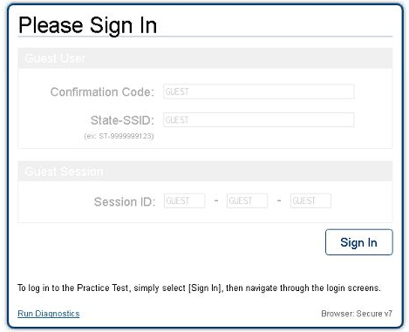
Student log-in steps (Cont.)
That will take them to the test sign-in page, which looks similar to this. Each student will have a card to fill in the below information.
In this area:
Students will enter:
Their SSID
10 digit number
Their first name
The test session
Provided by teacher
They should enter the words in the first space and the number(s) in the next field.

Slide 8
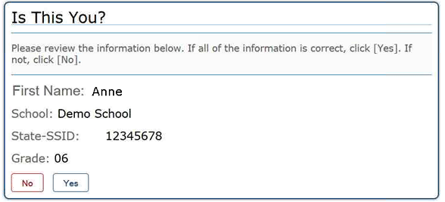
Student log-in steps (Cont.)
Students will then be directed to a ‘Is this you’ page.
Student should look and then check ‘yes’.

Slide 9
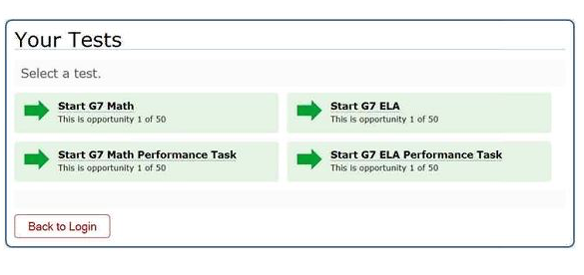
Student log-in steps (Cont.)
Students will then be taken to the test choice page. Please remind student which test they should choose as it is possible that multiple tests are highlighted in green. They should click right on the test option.

Slide 10
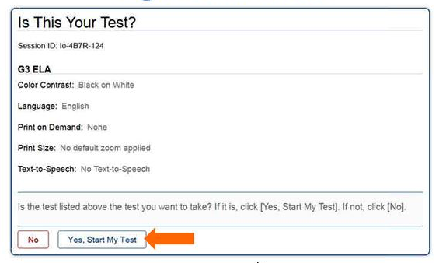
Student log-in steps (Cont.)
Finally students will be given this follow screen to ensure they are on the right test as well as their accommodations will be listed.

Slide 11
Student log-in steps (Cont.)
Finally, students will be a prompt to click the sound icon and and then click ‘yes’ regardless if they hear it or not. Be sure the to have your student click the sound icon or the program will not allow you to move on. The program has been adjusted to allow for you to adjust your volume while in the secured browser. (icon in the top left-hand corner once the test has begun)

Slide 12
Student Interface (need-to-knows)
Generally, avoid having students ‘pause’ the test. You can pause the test for 20 minutes before students are automatically timed out. (ALL STUDENT ANSWER ARE AUTOMATICALLY SAVED!)
In both the CAT portion and the Performance Assessment, the tests are divided into two portions, students will be prompted if they want to move on to the next portion. Once they move on, they cannot review any questions in the prior segment.
If the student screen is ‘spinning’ it is generally recommended to have it continue to ‘spin’ until an error pops up. (This won’t happen this year☺)

Slide 13
Student Interface (need-to-knows) Cont.
Students can take notes on scratch paper during any test segment (classroom activity, CAT or Performance Assessment), but they should be collected and destroyed after each segment of the test.
At the middle school level, headphones are recommended for the ELA CAT and Performance Assessment. Remind your students to bring their own from home.
At the elementary level, only students utilizing text-to-speech must have headphones.

Slide 14
Proctor Interface
We browsers, use Firefox or Google Chrome (you do not need to have a secured browser).
You can find the link to log into the Proctor interface on the NDSA resources page.
Use your email address as your username and your should have received password information from smarter balanced in the last couple of weeks.
Click the test administrator tab.
Then, click the test administration tab.

Slide 15
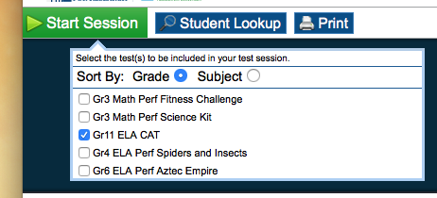
Proctor Interface (Cont.)
You will be directed to the main test session page.
Select the test session you wish to begin.
Be sure to pick the correct grade level and test.
If you are administering the Performance Task, be sure to pick ALL of the Different PTs for your grade level.
Once you choose your session, your start session button will turn green.

Slide 16
Proctor Interface (Cont.)
Once you click the ‘Start Session’ button, a test ID number will appear.
Write this down and save it. This is the session ID number that students need to populate the test. It also allows you to re-log into the session without logging the students out of the session. Generally, it is good practice to write this on the board for the students.

Slide 17
Proctor Interface (Cont.)
Once students use the test ID to log in, they will receive a message that the proctor must approve the session.
You can approve sessions by clicking the approval button and then hitting ‘approve’ for each student. Be sure that students have picked the right test prior to approving.
Be sure to be watching if there are students that need to be approved because it tends to take awhile for this to occur at times. You will know if students are waiting as you will see a number other than zero in parentheses.

Slide 18
Proctor Interface (Cont.)
After all students have entered into the test, you may monitor their progress.
This is handy as you can see how fast they are completing questions as students proceed through the test.

Slide 19
Proctor Interface (Cont.)
Try to avoid pausing test sessions as it will pause ALL students’ test sessions. This portion is working, but often creates issues.
Be sure to write down your test session ID! This is helpful if you happen to have your own computer freeze or have issues as it allows your to switch computers and not stop student testing.
If you have to end a test session prematurely, rest assured all student work will be saved, you need only ask all students to log out, create a new session and provide student the new session ID. When they log in, it will take them directly to where they left off.

Slide 20
Proctor Interface (Cont.)
Once you see that all students have completed the test session, you can click, end session and log out. If you forget to click ‘end session’ the program will automatically end the session as soon as you log out.
Once you have completed testing, be sure to collect all student notes/scratch paper and turn those into the school coordinator to be shredded.
Also, please record any student that did NOT complete their tests and turn that information into the school coordinator. Please provide a reason for not completing the test session.

Slide 21
QUESTIONS??

Slide 22
NDSA History
Mandan Proficiency Rates under NCLB
Proficiency rates 2002 Proficiency rates 2012
Math – 44% Math – 77%
(MHS 24%) (MHS 70%)
Reading – 63% Reading – 79%
(MHS 47%) (MHS 78%)

