Slide 1
Professional learning communities
It’s a Journey, Not a destination
The Three P’s to PLC’s
Policy
Professional Development
Practical Changes

Slide 2
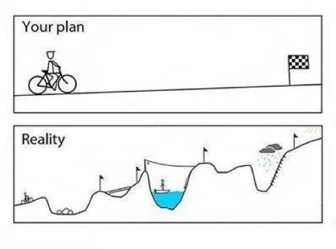
keep your eyes on the Destination!
Change is nonlinear!!
Notes:
PLCs are a process – they take time, investment and perseverance.

Slide 3
What is a PLC?
“A Professional Learning Community (PLC) is an ongoing process in which educators work collaboratively in recurring cycles of collective inquiry and action research to achieve better results for the students they serve.” (DuFour, DuFour, Eaker, & Many, 2016, p. 11)
  Mandan PLC Guide

Slide 4
The Four Questions
What do we want all students to learn?
  Guaranteed and Viable Curriculum
How will we know if they have learned it?
  System of Formative Assessment for Learning
How will we respond if they don’t learn it?
How will we respond if they have all ready learned it?
  System of intervention and enrichment

Slide 5
Necessary Pieces to a PLC System of Education
  Collaborative culture
    Is there a ’null curriculum’ for how staff members interact?
    Consensus is always better than voting
  Common language
    Do staff understand the foundation for PLCs and do they have a path?
  System for Common Formative Assessments
    Is there data available that allow for regular conversation about student learning?
  Structure for consistent meetings
    TIME – does your staff have it?

Slide 6
Changing the mindset in education

Slide 7
Initial Challenges
Lack of understanding / training (Buy – in)
Lack of common vocabulary (Consistency)
No time built into school schedules to provide regular meetings (Capacity)
Notes:
This requires an investment

Slide 8
Recognizing our assets
Strong RTI process at the elementary level
      Provided a system for effective collaboration
Standards-based reporting provided basis for movement
      Created a need for common summative assessments (k-5)
    Mandate for common assessments at secondary level
Notes:
Our collaborative culture was growing already due to SBRC and RTI at the elementary level
The process for a guaranteed and viable curriculum had begun

Slide 9
Necessary Policy changes
Contract language adjustments were needed
    Worked with teachers association and school board to provide compromise
    HS schedule had to be ‘Blown Up’
        Added two FTE’s to make the change
Notes:
These changes required compromise.
It also took providing a education to MEA members to help them to see benefits of PLC process.

Slide 10
Building understanding and capacity
        Set up training for all administrators for two days (ND Lead Center)
          Created a common sense of purpose
          Helped us to develop a common language for leaders
          Created a district guide for PLCs
Notes:
This really help to provide a vision for our admins.

Slide 11
Building understanding and capacity
Sent teacher leader teams to PLC Institutes
    Built teacher/administrator understanding and solidified a common purpose
    Helped to imbed teacher leaders within our system
    Provided momentum
Notes:
Teachers are delivering the message for us now.

Slide 12
Practical Changes
Rethinking professional development time
  ‘Traded’ 15 hours for staff to collaborate
      Plan allowed for secondary schools to build collaboration time
    Created summer assessment camps
        Collaborative time for teacher to talk about content
        Built capacity for helping teachers to learn to work together
        Helped to provide a guaranteed and viable curriculum
Notes:
This provided a task that our teachers could rally around.

Slide 13
Current Challenges
Getting everyone on the ‘bus’
Providing ongoing and effective Professional Learning
Ensuring Effective PLC meetings

Slide 14
Resources
Mandan Public Schools Teacher Resources
ALL Things PLC
Solution Tree
Dufour , R., Dufour, R., Eaker, R., & Many , T. (2016). Learning by Doing - A Handbook for Professional Learning Communities at Work (3rd ed.). Bloomington, IN: Solution Tree Press.
Hansen, A. (2015). How to Develop PLCs for Singletons and Small Schools . Bloomington, IN: Solution Tree Press.
Mandan Public Schools Teacher Resources

